Slide 1
History of Józef Wysocki
Made by:
Przemysław Pawliszko
Kacper Wrucha
Kiss Domonkos

Slide 2
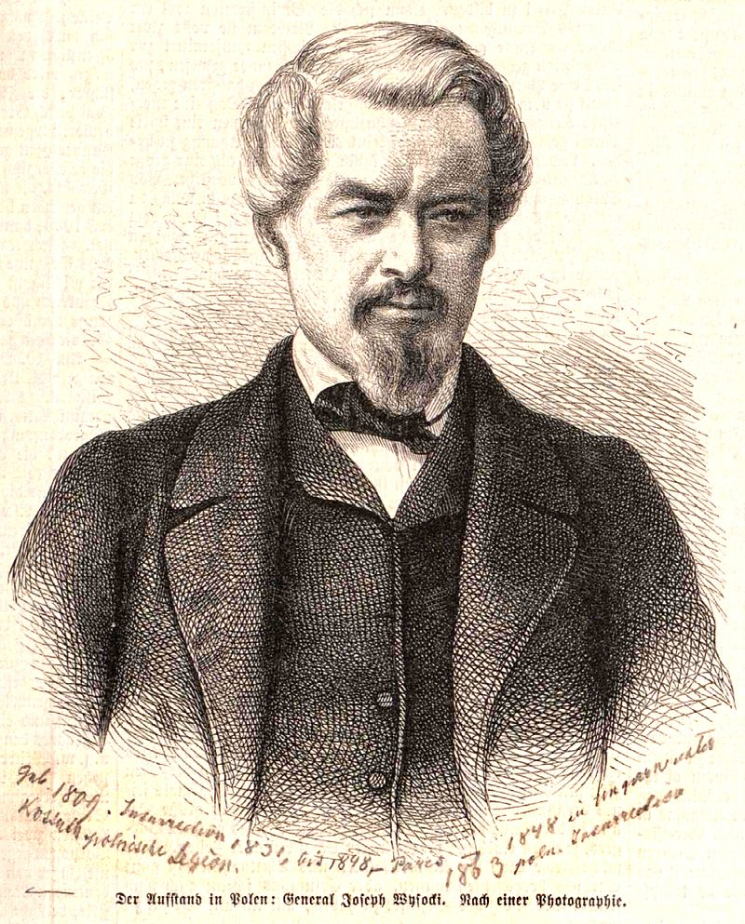
Who was Józef Wysocki
Józef Wysocki was a Polish general who helped Hungarian troops during Hungarian Uprising

Slide 3
Before the Hungarian Uprising
Before the Hungarian Uprising Józef Wysocki participated in the Polish uprising, however that one failed and he had to take refuge in Paris.

Slide 4
The Hungarian Uprising
When Hungarian Uprising started he took control of some Polish troops as well as Hungarian ones and led them to battle.
Despite intitial success his legions were defeated and had to retreat.
After some time he took control of another army and once again led them to battle.

Slide 5
Defeat
Despite strong effort and many victories in the end his troops were defeated at Temesvárig, which forced him to escape.
During his escape his troops accompanied him and Kossuth Lajos all the way to the border to make sure they are safe.
Before he left them for good he wrote a proclamation to the nation where he thanked everyone for their support.

Slide 6
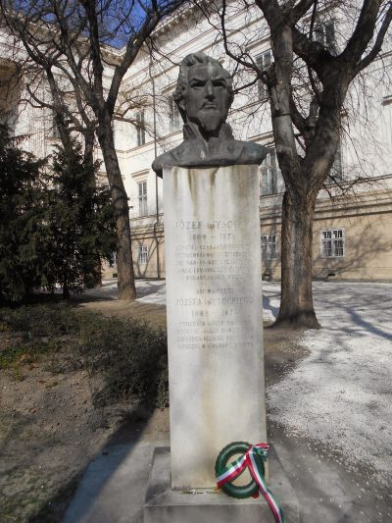
In Wysocki’s memory
Wysocki’s effort was not forgotten and right now his statue stands in Budapest.

Slide 7
The end
Thanks for your attention
Dzięujemy za waszą uwagę
Köszönjük a figyelmet !

