Slide 1
Józef Bem
By Olah Izolda, Kovacs Mira, Kamil Brzeziński

Slide 2
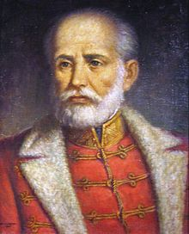
Who was Józef Bem
Józef Bem was born in Tarnów in Galicia, the area of Poland that had become part of the Habsburg Monarchy through the First Partition in 1772. He moved with his parents to Kraków, where after finishing military school (where he distinguished himself in mathematics) and joined the ducal forces as a fifteen-year-old cadet.

Slide 3
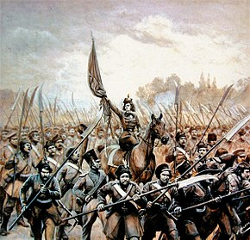
November Uprising
When the November Uprising, a struggle for Polish independence, broke out on November 29, 1830, against the Russian Empire, Bem immediately joined the Polish insurgents. He arrived in Warsaw, was given a major's commission and the command of the 4th Light Cavalry Battalion, which he led during the Battles of Iganie and Ostrołęka. During the Battle of Ostrołęka, Bem's forces bravely charged the Russian opponents. Although the Polish army suffered a serious defeat with a loss of 6,000 men, Bem's actions prevented the destruction of the entire army. For his valour on the battlefield, Bem was awarded the Virtuti Militari Golden Cross and promoted to the rank of Brigadier General. He was steadfastly against capitulation until the very end of the Uprising, during the desperate defence of Warsaw against Prince Paskievich (September 27, 1831). Nonetheless, the Polish army was eventually compelled to lay down arms on October 5, 1831, and crossed the Russian–Prussian partitional border under the command of General Maciej Rybiński in the Great Emigration.

Slide 4
First Exile
Bem then escaped to Paris, where he supported himself by teaching mathematics. In France, he published his next work, on the National Uprising in Poland, in which he not only gave an appraisal of the 1831 insurrection, but also tried to present a programme for the continuation of the struggle for the country's freedom.
In 1833 he went to Portugal to assist the liberal Dom Pedro against the reactionary Dom Miguel, but abandoned the idea when it was found that a Polish legion could not be formed there. When in Portugal, he was the target of an assassination attempt, carried out by Russian agents.

Slide 5
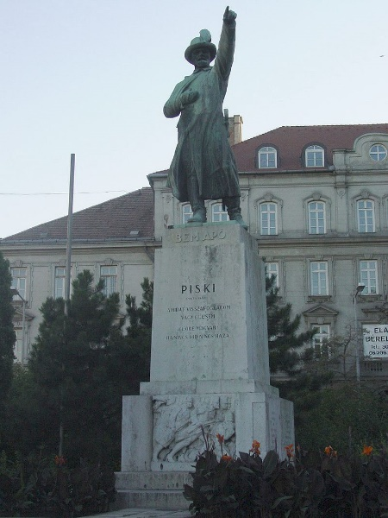
Hungarian Revolution of 1848
The Hungarian Revolution of 1848 (Hungarian: 1848–49-es forradalom és szabadságharc, "1848–49 Revolution and War") was one of the many European Revolutions of 1848 and closely linked to other revolutions of 1848 in the Habsburg areas. The revolution in the Kingdom of Hungary grew into a war for independence from the Austrian Empire, ruled by the Habsburg dynasty.
After a series of serious Austrian defeats in 1849, the Austrian Empire came close to the brink of collapse. Causing the new young emperor Franz Joseph I had to call for Russian help in the name of the Holy Alliance. Tsar Nicholas I answered, and sent a 200,000 strong army with 80,000 auxiliary forces. Finally, the joint army of Russian and Austrian forces defeated the Hungarian forces. After the restoration of Habsburg power, Hungary was placed under brutal martial law.
The anniversary of the Revolution's outbreak, 15 March, is one of Hungary's three national holidays.

Slide 6
Hero of 1848
A wider field for his activity presented itself in 1848 (along with the Austrian Revolution). First he attempted to hold Vienna against the imperial troops of Alfred I, Prince of Windisch-Grätz, and, after the capitulation, hastened to Pressburg (Hungarian: Pozsony, today Bratislava, Slovakia) to offer his services to Lajos Kossuth, first defending himself, in a long speech, from the accusations of "treachery to the Polish cause" and "aristocratic tendencies" ˙— which the more fanatical section of the Polish émigré Radicals repeatedly brought against him. He was entrusted with the defence of Transylvania at the end of 1848, and in 1849, as General of the Székely troops, he performed miracles with his little army, notably at the bridge of Piski on February 9, where, after fighting all day, he drove back an immense force of pursuers.

Slide 7
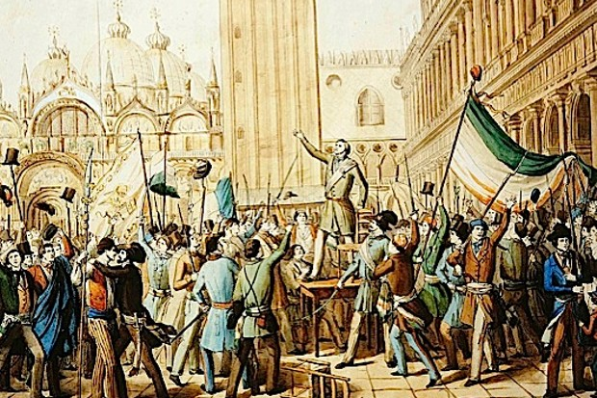
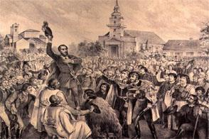
After relieving Transylvania he was sent to drive the Austrian General Anton Freiherr von Puchner out of the Banat region. Bem defeated him at Orşova on May 16, but the Russian invasion forced him to retreat to Transylvania. From July 12 to 22 he was fighting continually, but finally, on July 31, his army was annihilated by overwhelming numbers in the Battle of Segesvár (near Segesvár, now Sighişoara, Romania), Bem escaping only after feigning death. Yet he fought a fresh action at Nagycsür (now Romanian: Sura Mare, Romania) on August 6, and contrived to bring his fragmented army to the Battle of Temesvár (near Temesvár, now Timişoara, Romania), to aid the hard-pressed General Henryk Dembiński. Bem was in command and was seriously wounded in the last pitched battle of the war, fought there on August 9.

Slide 8
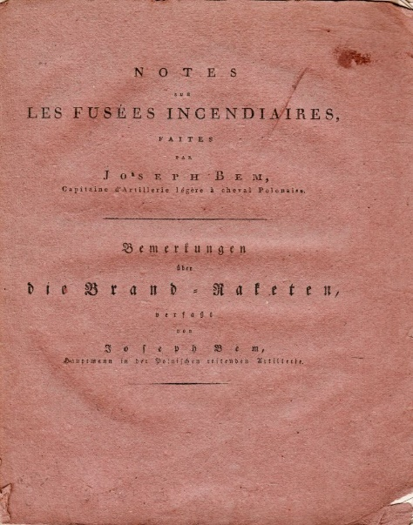
Works and Honors
Józef Bem died in 10 December 1850 in Aleppo Syria. He published in French, Polish and German languages books about the history of Poland, technology and military aspects:
Józef Bem – "La Pologne dans ses anciennes limites et l'empire des Russies" 1836
Józef Bem - "Notes sur les fusées incendiaires"
Józef Bem – "Erfahrungen über die Congrevischen Raketen" (Uwagi o rakietach zapalających, Practical Kowledge of Incendiary Rockets) 1820
Józef Bem – "O machinach parowych" (About Steam Engines)
Józef Bem – "Węgrzy i Polacy w dzisiejszym stanie Europy" (Hungarians and Poles in Contemporary Europe)
Józef Bem – "O powstaniu narodowym" (About National Uprisng)

Slide 9
Three commemorative postage stamps were issued on 10 December 1950 by Hungary on account of his death centenary.
A souvenir sheet was issued on 10 December 1950 by Hungary on Stamp Day.
On 15 March 1952 his stamp appears in Heroes of the 1848 Revolution series.
Poland issued a commemorative postage stamp on 15 July 1948 in Revolution Centenaries series.
Poland issued postage stamp on 10 December 1950 on his death centenary.

Slide 10
Thanks for your attention.

